Slide 1

A1ELOS Global Numerology
The science of numbers applied to your success.
Formal Business Presentation for Investors & Strategic Partners — August 1, 2026

Slide 2

About A1ELOS
A1ELOS Assessoria e Consultoria is a technology and knowledge holding company focused on high-performance numerology. We operate a sophisticated global platform that integrates millennia of numerical wisdom with cutting-edge Artificial Intelligence, delivering actionable insights to individuals, families, and corporations worldwide.
Our Mission
To democratize the science of numbers, making numerological intelligence accessible to every culture, language, and market on earth — empowering decisions through ancient wisdom amplified by modern AI.
15 specialized products and services covering every life and business dimension
12 languages with pricing adapted to each market's currency
~4 billion native speakers in our addressable market
Fully digital delivery — scalable, borderless, and low-cost

Slide 3

International Credibility
942242668
DUNS Number — Dun & Bradstreet (D&B)
A1ELOS holds the universally recognized D&B DUNS identifier, establishing our institutional credibility in every major economy on earth.
Globally Verified
B2B Homologation
Our credentials are recognized by governments, banks, and corporations in over 190 countries.
Fully valid for corporate contract qualification, procurement, and supplier onboarding processes.
Joint Ventures
Transaction Transparency
Facilitates cross-border partnerships and international joint ventures with institutional confidence.
Ensures full transparency in international financial and commercial transactions.
DUNS 942242668 is A1ELOS's trust seal — your guarantee of a verified, credible, and institutionally recognized global partner.

Slide 4
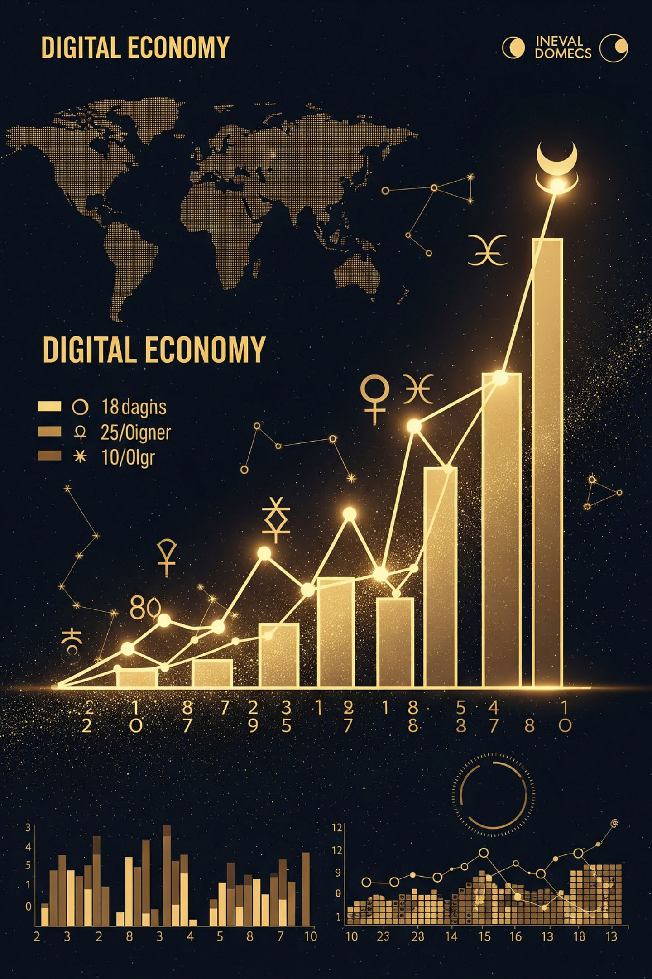
The Market Opportunity
$14.3B
Why Now?
The intersection of ancient numerological tradition with AI-driven personalization is creating a new consumer category. Millennials and Gen Z are driving demand for meaningful, data-backed self-discovery tools — and they're willing to pay premium prices for authenticity and precision.
A1ELOS is positioned at the exact center of this convergence — already operational, multilingual, and institutionally verified.
Global Market 2024
Astrology & numerology sector, growing at ~6% CAGR toward US$27B by 2035.
$4.7B
AI Apps 2025
Astrology and AI-powered apps, projected to reach US$11.7B by 2030 at 20% CAGR.
$1.4B
North America 2025
The North American segment alone, growing at 12.5% annually — a high-priority target market.

Slide 5
Product Portfolio — 15 Offerings
Every product is delivered digitally as a personalized PDF report, ensuring zero inventory costs and unlimited global scalability. Average ticket: US$6.00.
#
Product / Service
Price (USD)
Category
1
Express Map
US$1.60
Personal Basics
2
Life Phase / Year
US$1.60
Personal Basics
3
Complete Map
US$3.40
Personal Advanced
4
AI Name Search
US$3.40
AI-Powered
5
Ballot Name Validation
US$5.20
Specialized
6
Electoral Number
US$5.20
Specialized
7
Property Number
US$5.20
Specialized
8
Monthly Energy Calendar
US$5.20
Specialized
9
Artistic Name Validation
US$7.00
Premium
10
Baby Name Planning
US$7.00
Premium
11
Signature Validation
US$7.00
Premium
12
Business / Product Name
US$8.80
Corporate
13
Couple Map
US$8.80
Relationship
14
Premium Family Map
US$19.60
Premium Family
15
Corporate / Business Bonus
Price on Request
Enterprise B2B

Slide 6

Global Reach — 12 Languages
A1ELOS addresses a combined native-speaker market of approximately 4 billion people, with prices adapted to the purchasing power and dominant currency of each region.
🇨🇳 Chinese
🇮🇳 Hindi
1.3 Billion speakers
0.6 Billion speakers
🇪🇸 Spanish
🇺🇸 English
0.5 Billion speakers
0.4 Billion speakers
🇸🇦 Arabic
🇷🇺 Russian
0.37 Billion speakers
0.26 Billion speakers
🇧🇷 Portuguese — 0.26B
🇯🇵 Japanese — 0.13B
🇩🇪 German — 0.13B
🇫🇷 French — 0.08B
🇮🇹 Italian — 0.07B
🇮🇱 Hebrew — 0.05B

Slide 7
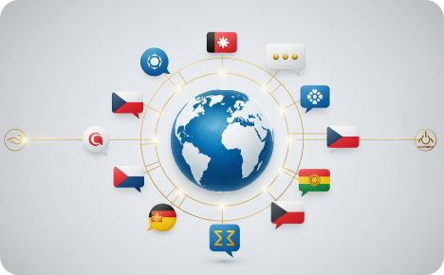


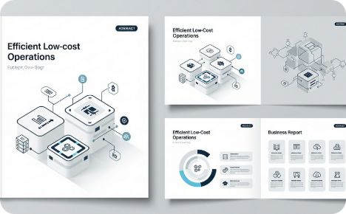
Competitive Advantages
A1ELOS is built on four structural pillars that no single competitor currently replicates in combination — creating a formidable moat in the global numerology market.
Linguistic Scalability
AI-Powered Analysis
Institutional B2B Credibility
Operational Efficiency
Our 12-language infrastructure opens a market 10x larger than typical Portuguese or English-only platforms. Each language version is culturally and numerologically adapted for local resonance.
Proprietary AI applied to name suggestions, vibrational analysis, and report generation — operating in a segment growing at 20% per year, with a significant competitive moat.
All 15 products are delivered as digital PDFs — zero inventory, zero logistics, near-zero marginal cost. Each additional sale flows almost entirely to the bottom line, enabling exceptional margin scaling.
The Corporate Bonus product, backed by DUNS 942242668, enables enterprise contracts with HR departments, marketing agencies, and multinational corporations seeking numerological advisory.

Slide 8
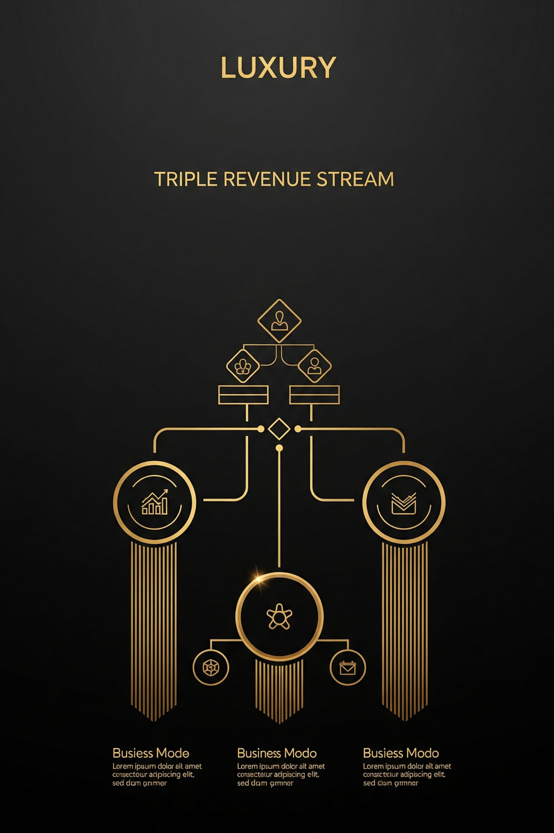



Business Model
A1ELOS operates three synergistic revenue streams, each reinforcing the others and collectively de-risking the overall revenue profile.
B2C Direct Sales
Personalized numerology reports sold directly to end consumers through our global multilingual platform. Low price point drives high volume; AI personalization drives retention and word-of-mouth referrals.
B2B Corporate Bonus
Customized enterprise numerology packages for HR teams, marketing departments, and corporate clients. Bespoke scope and pricing with progressive volume discounts, underpinned by DUNS-verified credibility.
Geolocated Advertising
Premium banner placements segmented by country, continent, or worldwide audience. Fixed and time-limited contracts available, with contractually assured annual price adjustment provisions.

Slide 9
Media Rate Card — Advertising
A1ELOS offers brands, agencies, and media buyers premium, numerology-audience-targeted advertising placements with guaranteed visibility across our 12-language global platform.
Targeting Scope
Fixed Banner (Monthly)
Temporary (Campaign)
Country
US$160 / month
US$100 / month
Continent
US$360 / month
US$240 / month
Worldwide
US$700 / month
US$500 / month
Exclusive Sponsorship
US$1,200 / month
US$900 / campaign
Fixed Banners
Temporary Campaigns
Higher value for sustained, always-on brand exposure. Ideal for brands seeking continuous presence with a globally engaged, spiritually curious, high-intent audience.
30, 60, or 90-day campaign windows at a more accessible entry price. Perfect for product launches, seasonal promotions, and new-market entry strategies. Annual price updates contractually assured.

Slide 10
Year 1 Financial Projections
CONSERVATIVE SCENARIO
Optimistic Scenario
Period
Visitors
Sales
Revenue
With paid traffic campaigns and strategic partner activations, annual revenue can reach:
Daily
300–800
3–12
US$18–72
Monthly
9,000–24,000
90–360
US$540–2,160
US$200,000
Annual
110K–290K
1,100–4,300
US$6,600–26,000
in Year 1 alone — driven by targeted ads, affiliate channels, and B2B contract activations.
These projections reflect organic growth only — no paid advertising. Conversion rates are conservatively modeled at 1–1.5% of total visitors, consistent with digital content commerce benchmarks.

Slide 11
Long-Term Vision
A1ELOS is designed for compounding growth — each year building brand equity, language depth, AI capability, and institutional partnerships that make the next milestone more achievable than the last.
1
Year 1–2: Launch & Validation
Platform live in 12 languages, organic revenue, first B2B contracts, DUNS-backed credibility established.
Year 5: US$100K–$300K
2
Brand consolidation across key Western and LATAM markets. AI tools mature. Advertising revenue stream fully operational with recurring brand clients.
Year 10: US$600K–$1.6M
3
Leadership in Asian and Western markets. Corporate Bonus product generating significant B2B revenue. Joint ventures active across multiple continents.
Year 20: US$3M–$8M
4
A global numerology consulting ecosystem — the definitive authority in AI-powered numerical intelligence for individuals, families, and enterprises worldwide.

Slide 12

Partnership Opportunities
A1ELOS welcomes investors, media groups, technology partners, and international brands to join a high-growth platform at the intersection of ancient wisdom and modern AI.
Media & Advertising Partners
B2B Expansion — Corporate Networks
Access a globally segmented, spiritually engaged audience through our geolocated banner placements. Country, continent, or worldwide targeting — fixed or campaign-based contracts. Ideal for lifestyle, wellness, finance, and self-development brands.
HR consultancies, executive coaching firms, and marketing agencies can white-label or co-sell the Corporate Bonus product to their client base. Progressive volume discounts and custom scope make it highly flexible for enterprise distribution.
International Joint Ventures
AI Co-Development
DUNS 942242668 makes A1ELOS immediately eligible for cross-border business agreements. We actively seek regional master licensees, language-market operators, and platform co-development partners in Asia, the Middle East, and North America.
Technology investors and AI labs are invited to co-develop next-generation numerological intelligence tools — expanding the product portfolio and deepening the platform's proprietary moat in an underserved and rapidly growing market.

Slide 13

A1ELOS Global Numerology
The science of numbers applied to your success.
DUNS Number
Platform
942242668
Dun & Bradstreet — Globally Verified
15 Products · 12 Languages · ~4 Billion Speakers
Contact
Investors & Strategic Partners
A1ELOS Assessoria e Consultoria
© A1ELOS Assessoria e Consultoria — All rights reserved. August 1, 2026.

